Slide 1
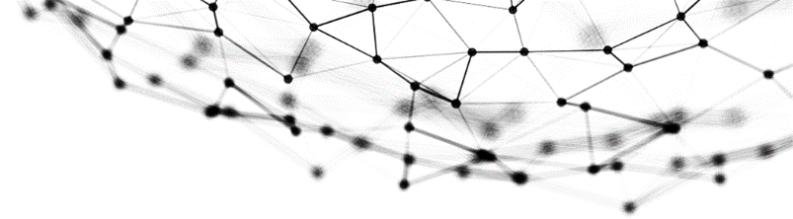


F42 BLOCKCHAIN
Group member
HUANG Zheng LUO Suhai
LIN Lixin ZHAO Yuhao
ZHU Jun SHEN Linling

Slide 2
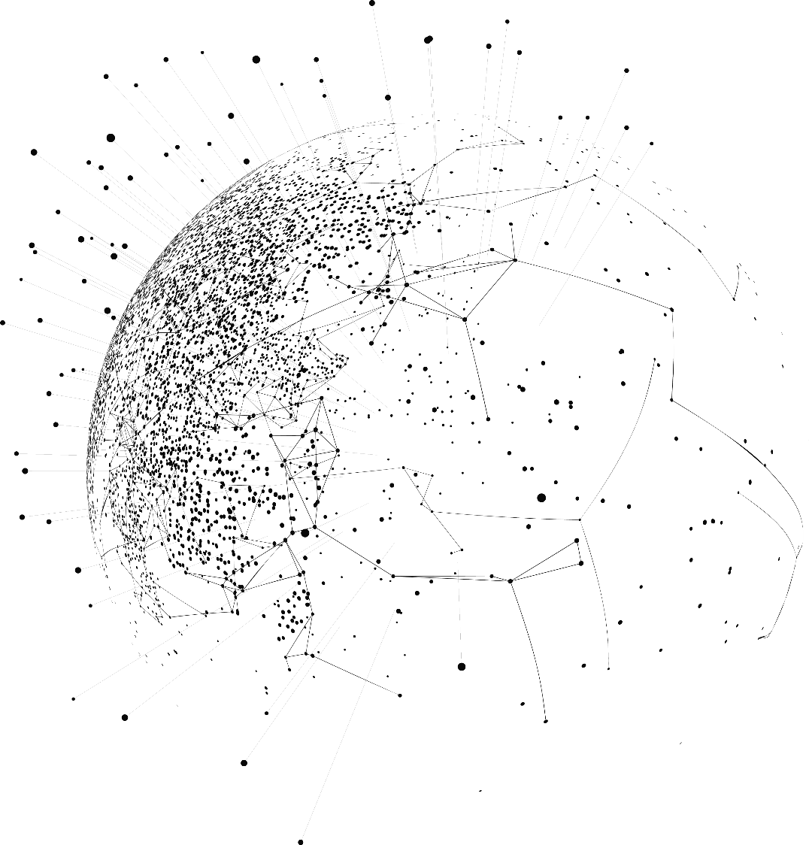
Content
01
Problem definition
& Objectives
02
Solution design
03
Implementation & Deployment

Slide 3
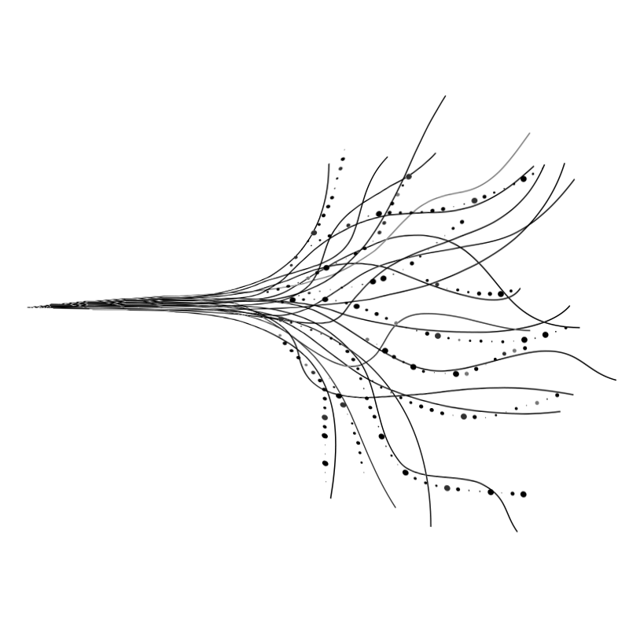
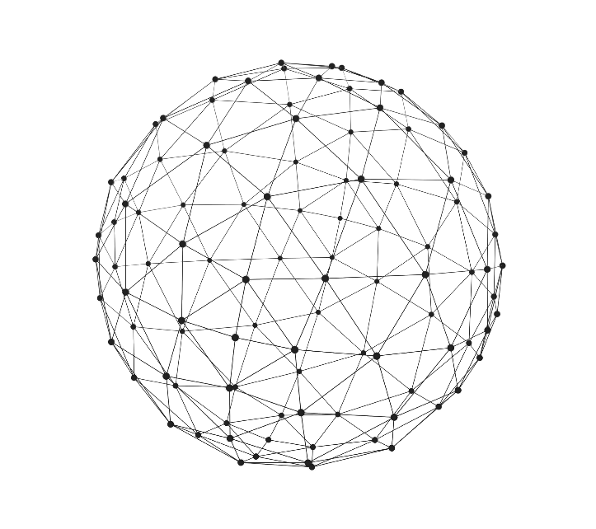
Part 1
Problem definition
&Objectives

Slide 4
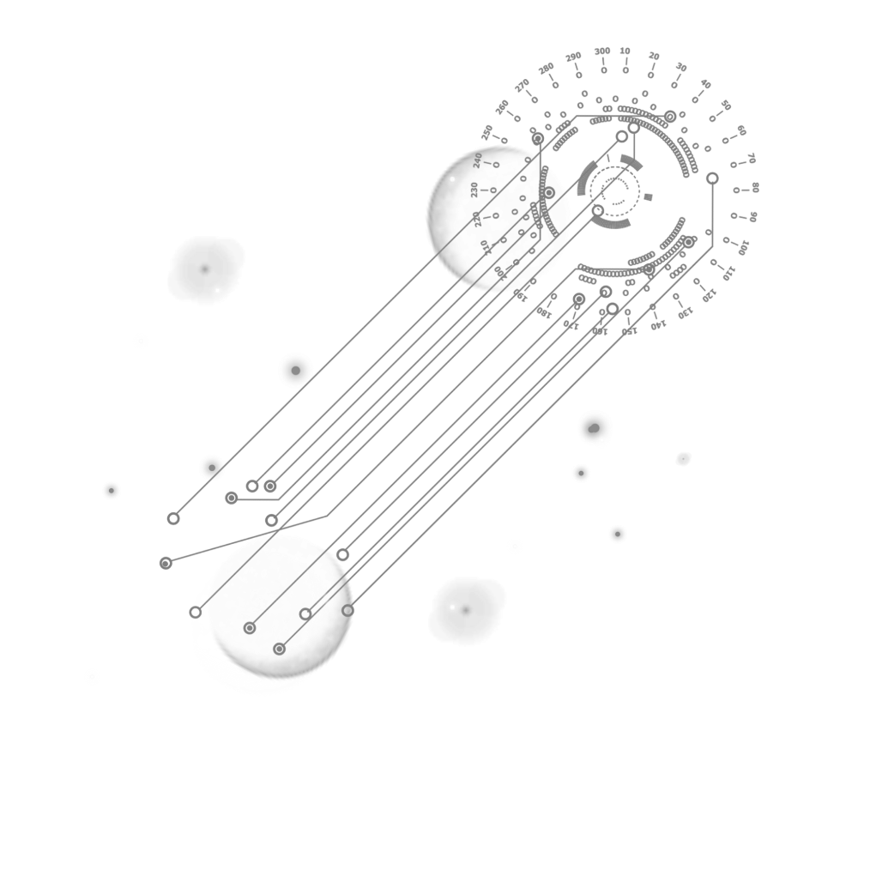
BUG
issue
Problem definition
Study Ethereum's working procedures and find out potential problems, then clarify the cause and try to provide a possible solution. Engage in background material readings and help identify issues.
The top 10 most popular vulnerabilities on Ethereum right now

Slide 5
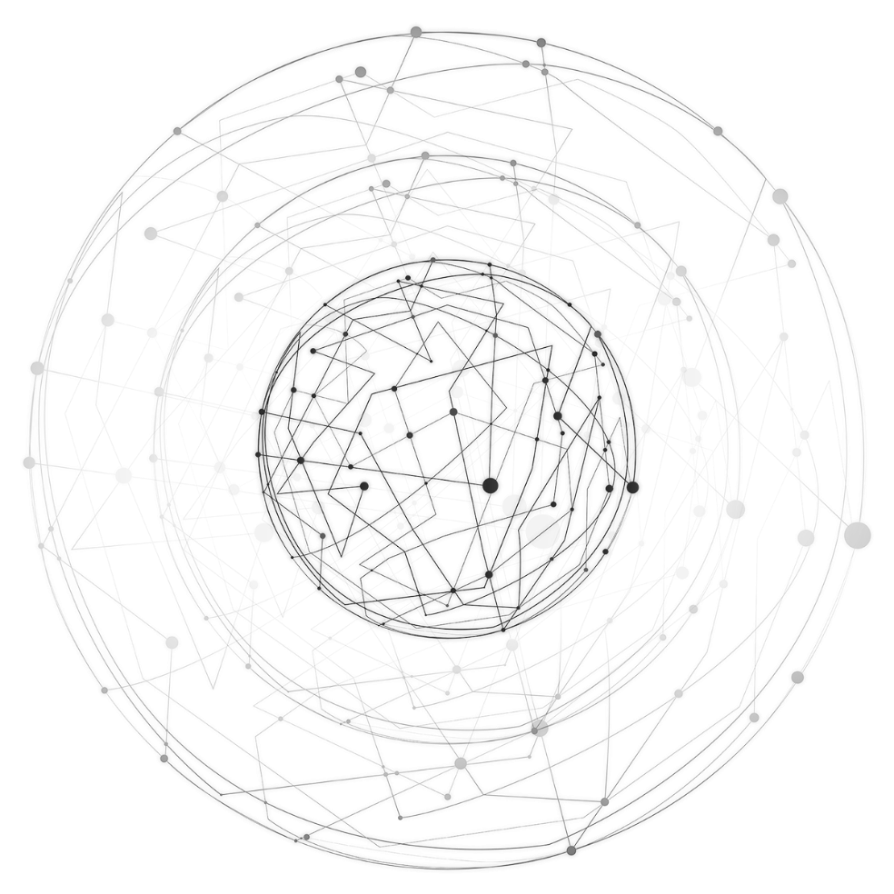


Objective
Simplify the smart contract security audit process and offer an automated tool for detecting common vulnerabilities.
Through deep integration with Slither, the platform is capable of quickly and accurately identifying Our primary objective in developing this platform was to simplify the smart contract security audit process and offer an automated tool for detecting common vulnerabilities.

Slide 6
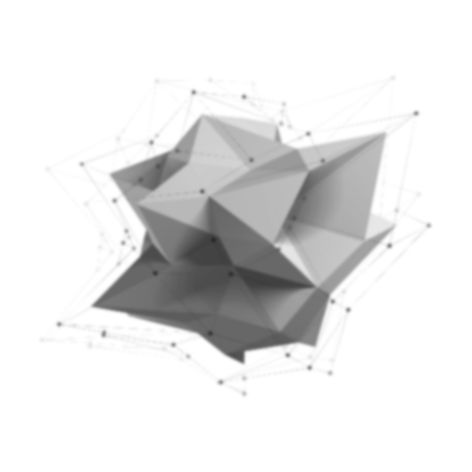

以太坊综述（本部分为综述总结）
以太坊简介
1.开源的、具有智能合约功能的公共区块链平台
2.本质是保存数字交易永久记录的公共数据库
3.去中心化、去信任化的分布式账本技术
4.由数据块组成链式结构，数据难以篡改
工作原理
1.用户通过钱包发送交易或部署智能合约
2.网络节点验证并在以太坊虚拟机（EVM）中执行
3.验证结果打包成区块添加到区块链
智能合约
1.用编程语言编写，执行后记录不可篡改
2.保证交易透明公开与合法性
以太坊虚拟机（EVM）
1.网络核心，负责执行合约代码
2.分布式执行确保可靠性和安全性

Slide 7
以太坊综述（本部分为我对sll综述总结 可删去）
哈希函数的应用
用于交易和区块加密验证
哈希函数特性
唯一性（抗碰撞性）、单向性、雪崩效应
主要哈希算法
1.SHA - 256 和 Keccak – 256
2.Keccak - 256 应用广泛（地址生成、智能合约、挖矿、安全性等）
以太坊面临的挑战（后面部分会细说）
未来发展方向
1.共识机制
2.分片技术
3.layer2网络层

Slide 8


Potential problems with Ethereum's mature smart contracts and their solutions
安全漏洞与攻击 - 重入攻击
Security Breaches & Attacks - Re-entrancy attacks
The DAO hack incident is one example. In this type of attack, the malicious contract repeatedly calls back the vulnerable contract before the initial function is completed, resulting in a depletion of funds.
Solution
This risk can be mitigated by implementing a check-effect-interaction pattern, using re-entrancy protection like ReentrancyGuard in OpenZeppelin, and having a full audit of the contract.

Slide 9
Potential problems with Ethereum's mature smart contracts and their solutions
安全漏洞与攻击 - 重入攻击
Integer Overflow and Underoverflow
This occurs when an arithmetic operation exceeds the maximum or minimum value that the variable can hold
Solution
Use the SafeMath library, which is widely adopted by the Ethereum community, to help prevent these issues by ensuring safe arithmetic operations.

Slide 10
Potential problems with Ethereum's mature smart contracts and their solutions
安全漏洞与攻击 - 重入攻击
Phishing and Social Engineering
Users may be tricked into interacting with malicious contracts or websites that appear legitimate.
Solution
Educating users about the risks of phishing, promoting security practices such as double-checking URLs, and using tools to warn users about unverified contracts can help reduce these risks.

Slide 11
Potential problems with Ethereum's mature smart contracts and their solutions
安全漏洞与攻击 - 重入攻击
Front-running
This occurs when an attacker observes a pending transaction and places a similar transaction with higher gas fees to be mined first.
Solution
Techniques like commit-reveal schemes and adding randomness to transaction data can help prevent front-running. Layer 2 solutions and other off-chain mechanisms can also offer protection.

Slide 12
Potential problems with Ethereum's mature smart contracts and their solutions
安全漏洞与攻击 - 重入攻击
Scalability Issues
As the Ethereum network grows, scalability becomes a pressing concern. High demand can lead to network congestion, driving up gas fees and making transactions slow and expensive.
Solution
The Ethereum 2.0 upgrade aims to address scalability through the introduction of sharding
and a transition from Proof of Work (PoW) to Proof of Stake (PoS). Layer 2 solutions like Optimistic Rollups and zk-Rollups also promise to enhance scalability by processing transactions off-chain and settling them on-chain.

Slide 13
Potential problems with Ethereum's mature smart contracts and their solutions
安全漏洞与攻击 - 重入攻击
Complexity and User Experience
InteractingWith smart contracts can be complex and intimidating for non-technical users.
Solution
Improving the user interface and user experience (UI/UX) of decentralized applications (dApps), providing clear documentation, and offering user-friendly wallets and tools can enhance usability. Projects like MetaMask have made significant strides in making Ethereum more accessible.

Slide 14
Potential problems with Ethereum's mature smart contracts and their solutions
安全漏洞与攻击 - 重入攻击
Gas Fees
Fluctuating gas prices can make it difficult for users to predict costs, leading to either overpayment or failed transactions due to underpayment.
Solution
Implementing gas optimization techniques within smart contracts and educating users on setting appropriate gas limits can help. EIP-1559, which was implemented in the London hard fork, introduces a base fee model to make gas fees more predictable.

Slide 15
Potential problems with Ethereum's mature smart contracts and their solutions
安全漏洞与攻击 - 重入攻击
Regulatory and Legal Risks
Smart contracts operate in a relatively new and evolving regulatory landscape. Legal uncertainties can pose risks for both developers and users.
Solution
Staying informed about regulatory developments, engaging with legal experts, and considering compliance from the outset of contract development can help mitigate legal risks. Additionally, adopting decentralized governance models can distribute regulatory risk among a broader community.

Slide 16
Potential problems with Ethereum's mature smart contracts and their solutions
安全漏洞与攻击 - 重入攻击
Code Immutability
Once deployed, smart contracts on Ethereum are immutable, meaning they cannot be altered. This immutability can be a double-edged sword; while it ensures trustlessness and security, it also means that bugs and vulnerabilities cannot be easily fixed.
Solution
Implementing upgradeable contract patterns, such as the Proxy pattern, allows developers to introduce new logic while maintaining the same contract address. Rigorous testing, peer reviews, and professional audits before deployment are also crucial.

Slide 17
Potential problems with Ethereum's mature smart contracts and their solutions
安全漏洞与攻击 - 重入攻击
Oracles and external data dependencies
Smart contracts often rely on external data sources (oracles) to execute functions based on real-world events. If an oracle is compromised, it can lead to incorrect or malicious contract behavior.
Solution
Using decentralized oracles like Chainlink can reduce the risk of a single point of failure. Ensuring that multiple oracles are used and implementing fallback mechanisms can provide additional security.

Slide 18
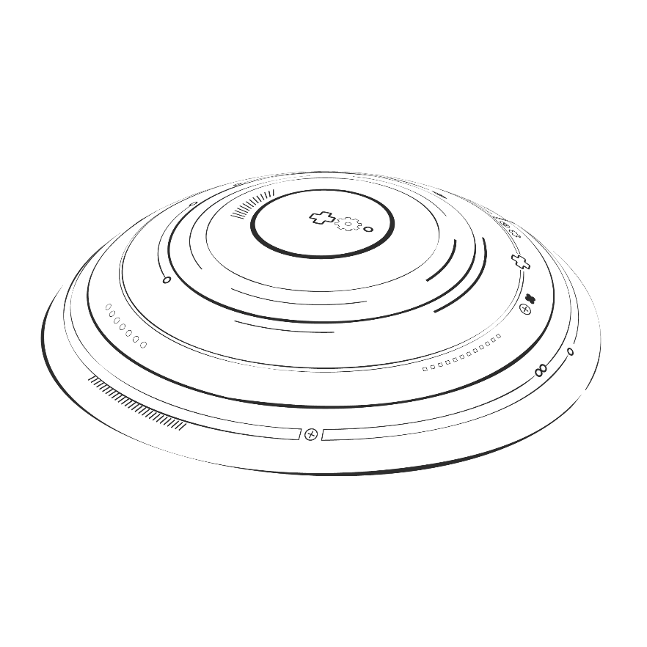
Mature smart contracts on Ethereum provide innovative solutions to traditional centralized systems, but they also face many challenges. Addressing security vulnerabilities through best practices and audits, leveraging Ethereum 2.0 and Layer 2 solutions to improve scalability, improve availability, comply with regulations, manage code immutability, and securely integrate oracles are key steps in mitigating potential issues. As the ecosystem grows, continuous improvement and vigilance will be key to realizing the full potential of smart contracts.
summary

Slide 19
Part 2
Solution design

Slide 20
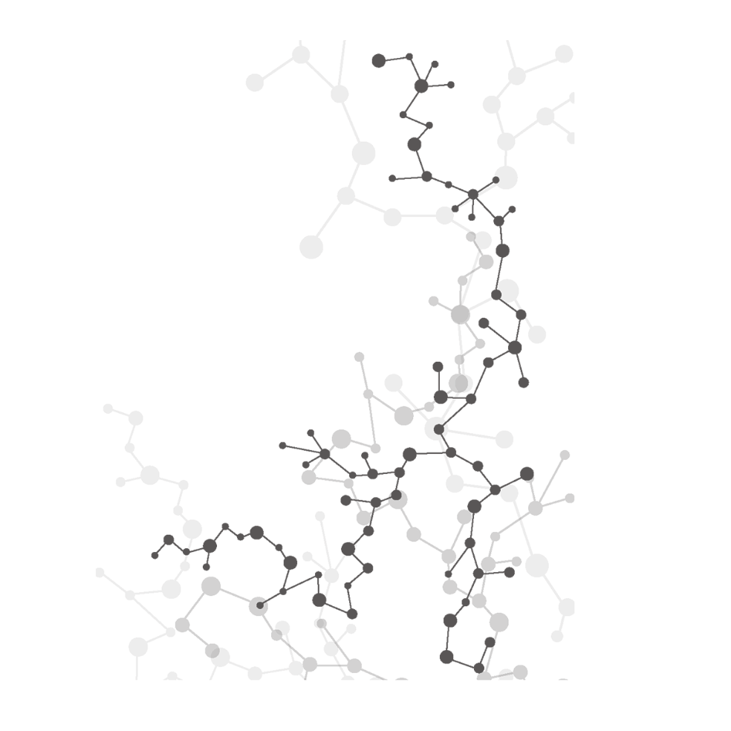
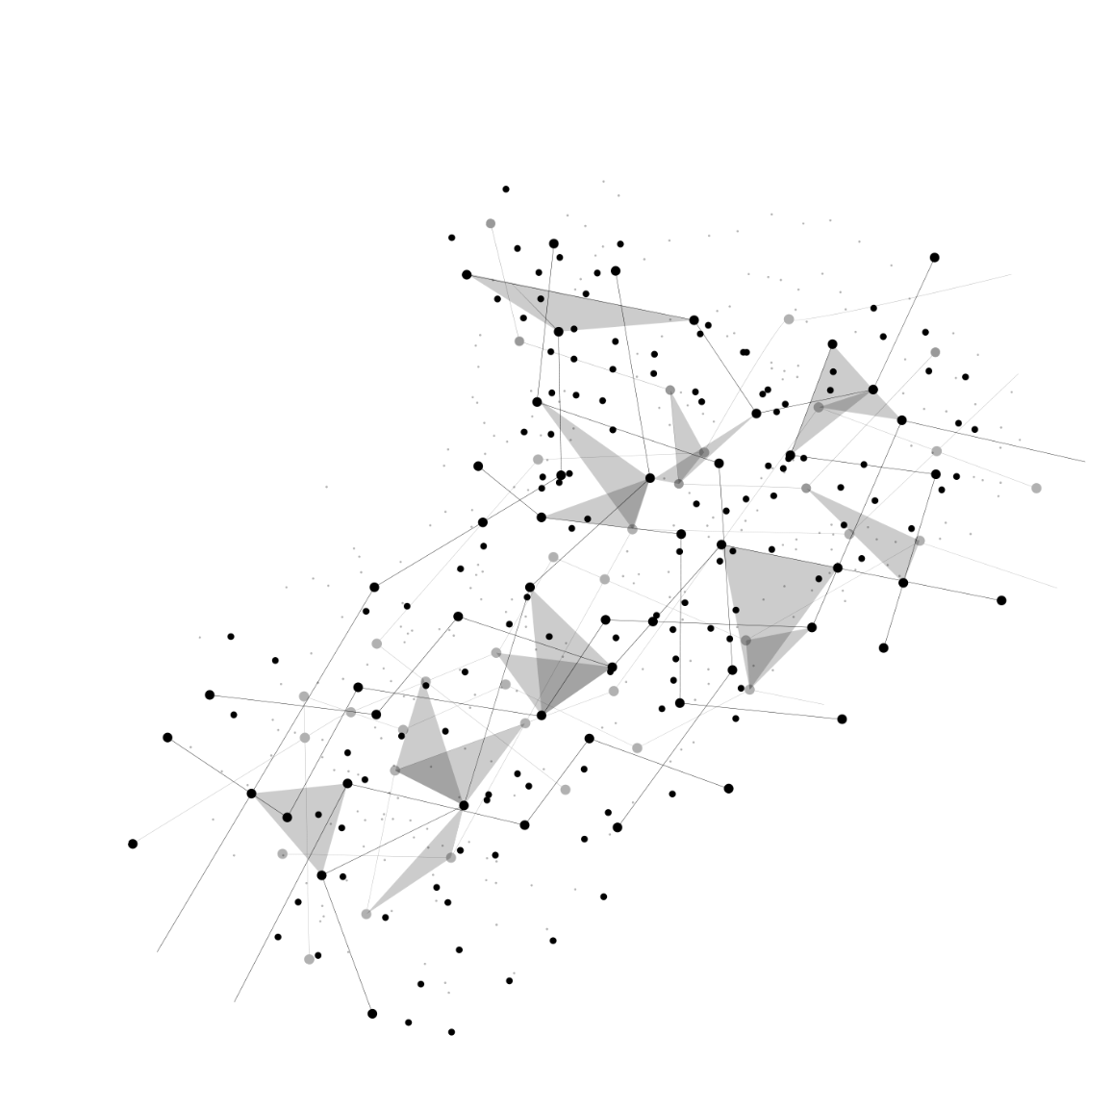
运行过程
Smart contract code reproduction
Phase I
实施
阶段
Substitution for vulnerability detection
Phase II
Bug fixes and bug improvements
Phase III

Slide 21
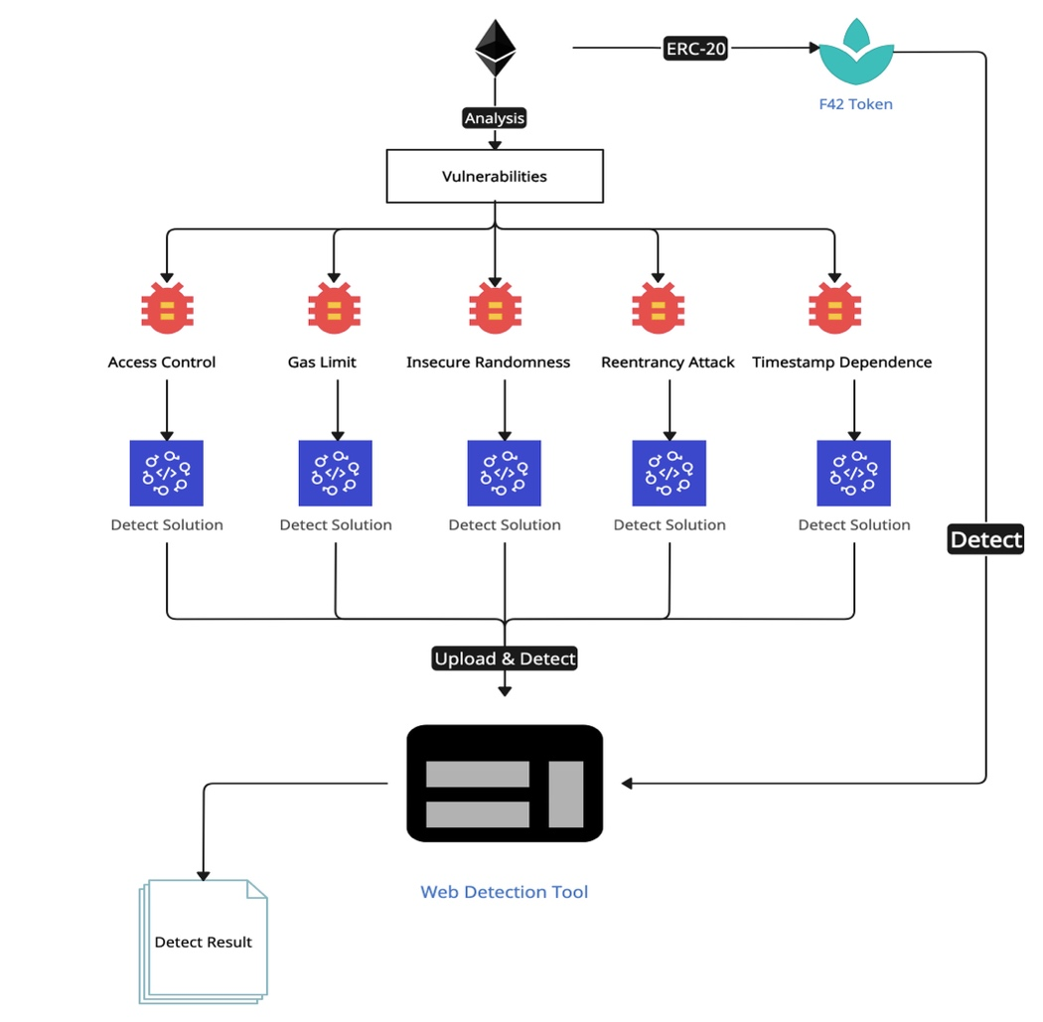

Project workflow

Slide 22
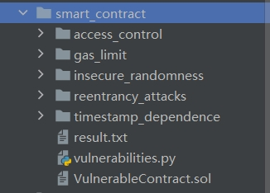
Smart contract reproduction
1. Find a smart contract with a vulnerability (corresponding to the file on GitHub)
2. Write a first-generation smart contract

Slide 23
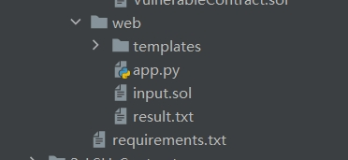

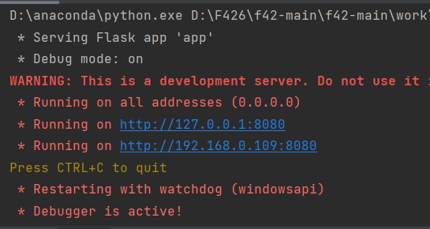



Code Instrumentation Tool (Find Vulnerabilities)

Slide 24


Fix bugs

Slide 25
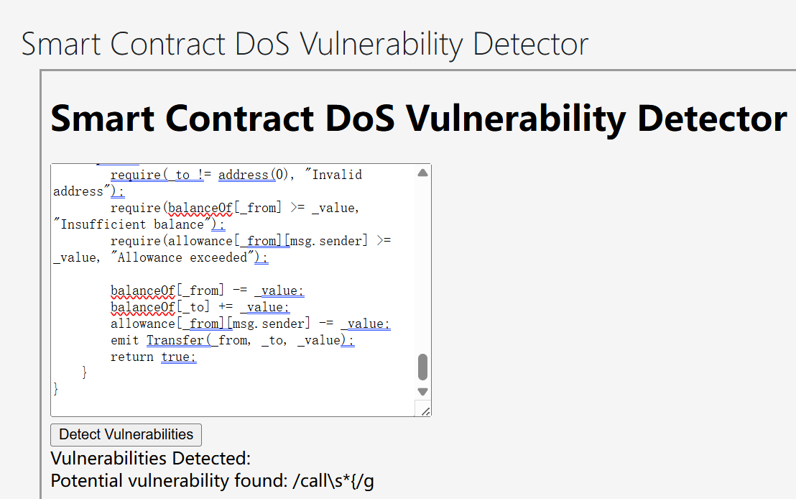
Fix bugs
Follows ERC-20 standards Develop a proposed cryptocurrency
https://github.com/RockyRori/f42/tree/main/contract
See what's wrong with this simple cryptocurrency under the ERC-20 standard Check using the tools provided by the teacher during the lesson
https://lms.ln.edu.hk/mod/resource/view.php?id=739976
Check in turn according to the documents provided by the teacher
https://github.com/OWASP/www-project-smart-contract-top-10/tree/main/2023/en/src

Slide 26
Part 3
Implementation & Deployment

Slide 27

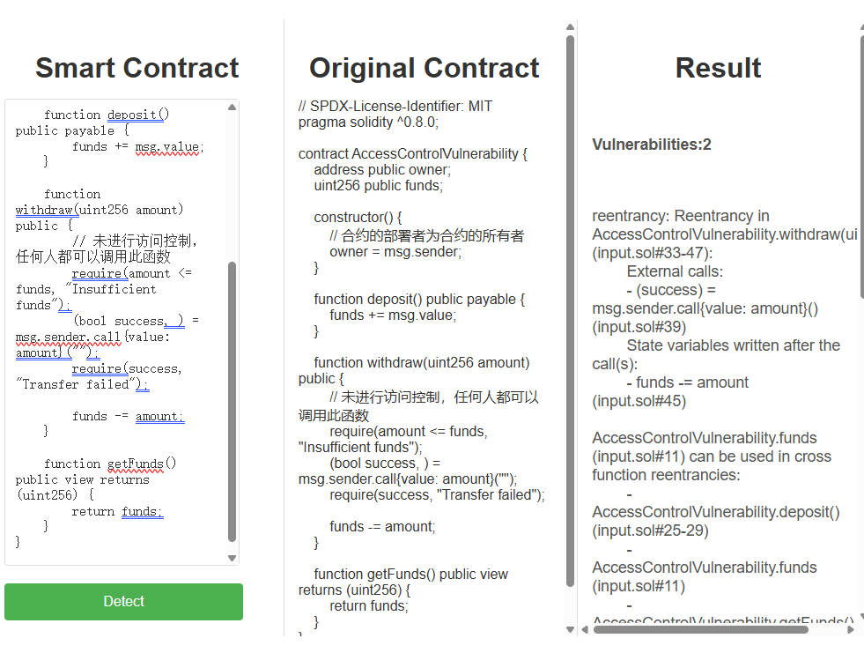
Enter the contract in the web
Check access control
如图

Slide 28
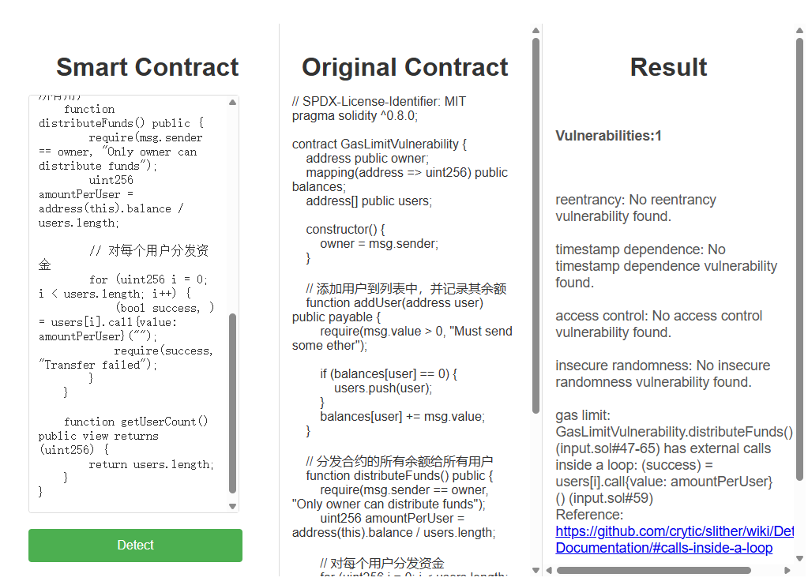
Enter the contract in the web
Check gas limit
如图

Slide 29
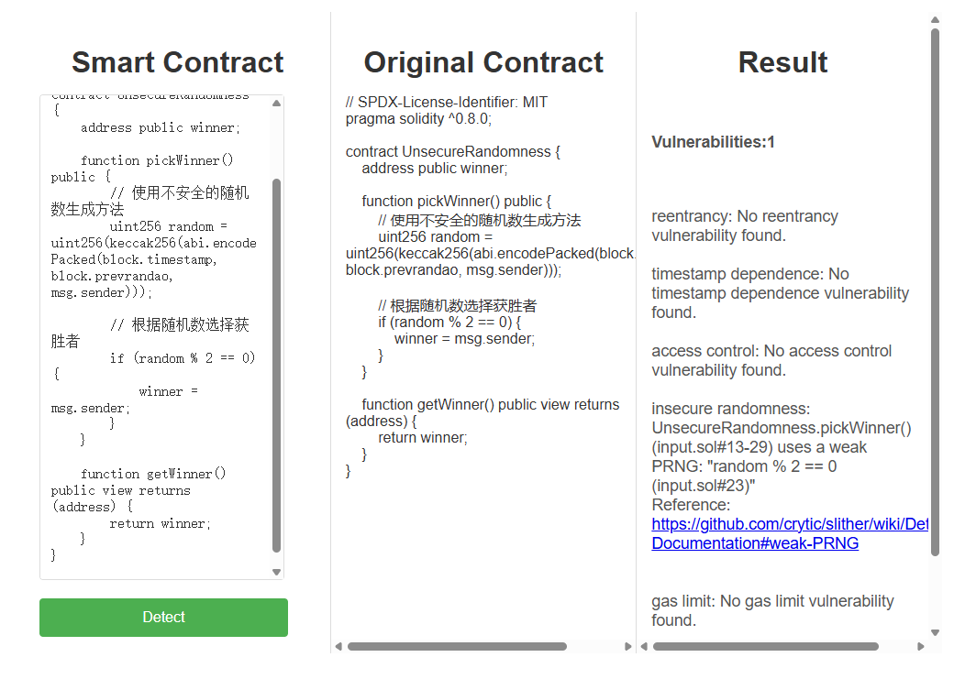
Enter the contract in the web
Check insecure randomness
如图

Slide 30
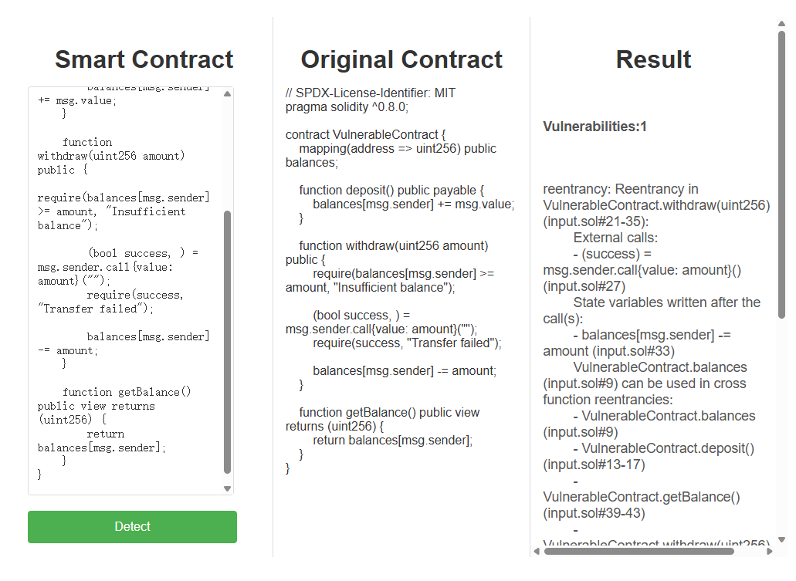
Enter the contract in the web
Check reentrancy
如图

Slide 31
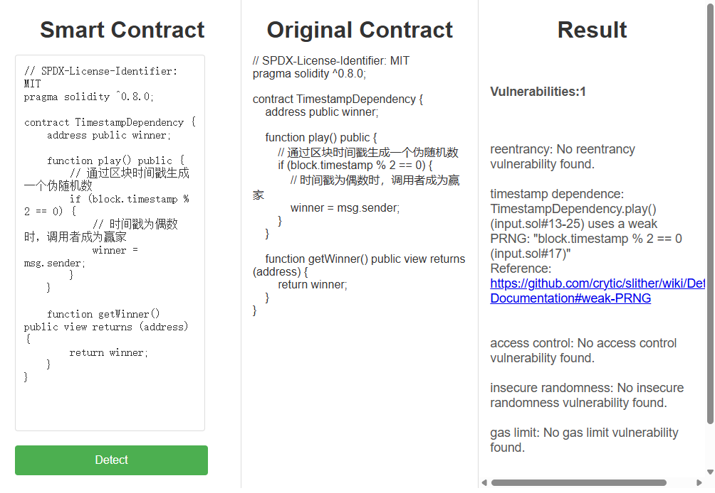
Enter the contract in the web
Check timestamp dependence
如图

Slide 32
Conclusion
In this project, we designed and implemented a vulnerability detection platform for Solidity smart contracts, based on the Flask web framework. By integrating the powerful Slither static analysis tool, our platform can automatically detect common security vulnerabilities in user-uploaded Solidity smart contracts. Through this platform, we aim to provide a convenient and efficient tool to identify potential security issues in smart contracts.
Platform Objective Our primary objective in developing this platform was to simplify the smart contract security audit process and offer an automated tool for detecting common vulnerabilities. Through deep integration with Slither, the platform is capable of quickly and accurately identifying typical security risks in smart contracts, helping developers uncover and fix these issues early to ensure the security of their contracts.

Slide 33

Literature references
inoutcode/ethereum_book
https://github.com/inoutcode/ethereum_book
ethereum - Google Scholar
https://scholar.google.com/scholar?hl=en&as_sdt=0%2C5&q=ethereum&btnG=
Ethereum Whitepaper | ethereum.org https://ethereum.org/en/whitepaper/#a-next-generation-smart-contract-and-decentralized-application-platform
Ethereum Price, Chart, Market Cap, ETH Coin Essentials | CoinLore https://www.coinlore.com/coin/ethereum
Introduction to Smart Contracts — Solidity 0.8.28 documentation https://docs.soliditylang.org/en/v0.8.28/introduction-to-smart-contracts.html
bibliography
REFERENCE DOCUMENTATION

Slide 34

校徽
谢谢观看
F426

